Slide 1



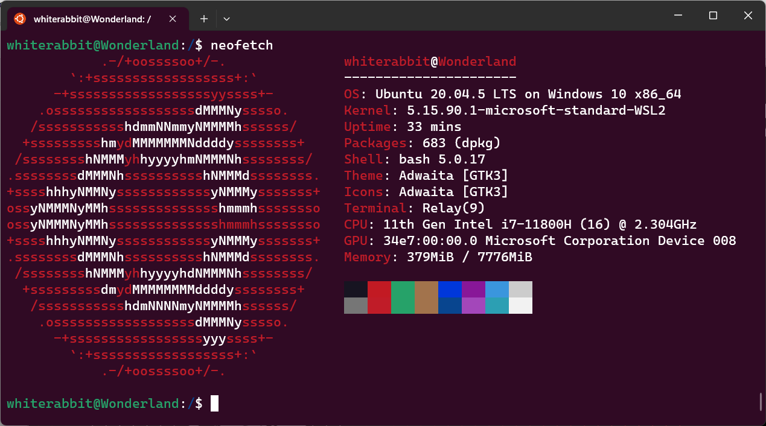
Introduction to Linux

Slide 2
Agenda
What is GNU/Linux
GUI Vs. Terminal
Navigation and Some Commands

Slide 3

What is GNU/Linux?
What do you think Linux is?
What do you think GNU is?
Wait… what?
Which has the cooler mascot?

Slide 4
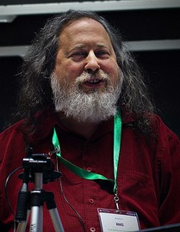
GNU
GNU was launched by Richard Stallman (rms) in 1983, as an operating system which would be put together by people working together for the freedom of all software users to control their computing. rms remains the Chief GNUisance today.
The primary and continuing goal of GNU is to offer a Unix-compatible system that would be 100% free software. Not 95% free, not 99.5%, but 100%. The name of the system, GNU, is a recursive acronym meaning GNU's Not Unix—a way of paying tribute to the technical ideas of Unix, while at the same time saying that GNU is something different. Technically, GNU is like Unix. But unlike Unix, GNU gives its users freedom.
Richard Stallman (rms)
https://www.gnu.org/gnu/about-gnu.html

Slide 5
GNU Philosophy
Free software means that the software's users have freedom. (The issue is not about price.) We developed the GNU operating system so that users can have freedom in their computing.
Specifically, free software means users have the four essential freedoms: (0) to run the program, (1) to study and change the program in source code form, (2) to redistribute exact copies, and (3) to distribute modified versions.
Software differs from material objects—such as chairs, sandwiches, and gasoline—in that it can be copied and changed much more easily. These facilities are why software is useful; we believe a program's users should be free to take advantage of them, not solely its developer.
https://www.gnu.org/philosophy/philosophy.html

Slide 6

Linux
Linux is a clone of the operating system Unix, written from scratch by Linus Torvalds with assistance from a loosely-knit team of hackers across the Net. It aims towards POSIX and Single UNIX Specification compliance.
It has all the features you would expect in a modern fully-fledged Unix, including true multitasking, virtual memory, shared libraries, demand loading, shared copy-on-write executables, proper memory management, and multistack networking including IPv4 and IPv6.
Although originally developed first for 32-bit x86-based PCs (386 or higher), today Linux also runs on a multitude of other processor architectures, in both 32- and 64-bit variants.
Linus Torvalds
https://www.kernel.org/linux.html

Slide 7
Wait… what?
Isn’t GNU and Linux both Operating Systems?
  Eh, depends on who you ask
GNU is an implementation of POSIX, but more importantly a Philosophy of how software should be developed and distributed
Linux is a kernel. That is it’s the core code of what makes an Operating System work
GNU developed software gives that kernel a “user land” and allows us to actually use the dang thing

Slide 8




Linux Distributions
These are packages of software distributed to make our lives easier. You can download and compile the Linux kernel yourself and add GNU software to it all day.

Slide 9
Mascot Battle!

Slide 10
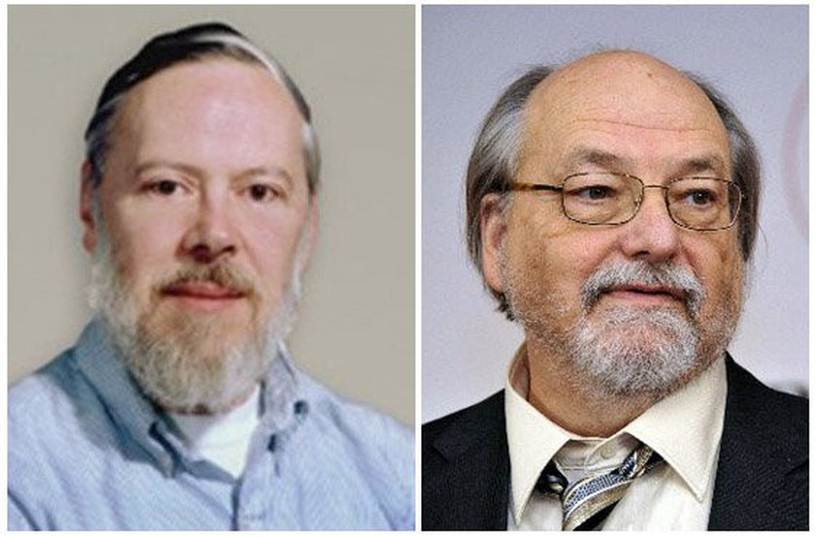
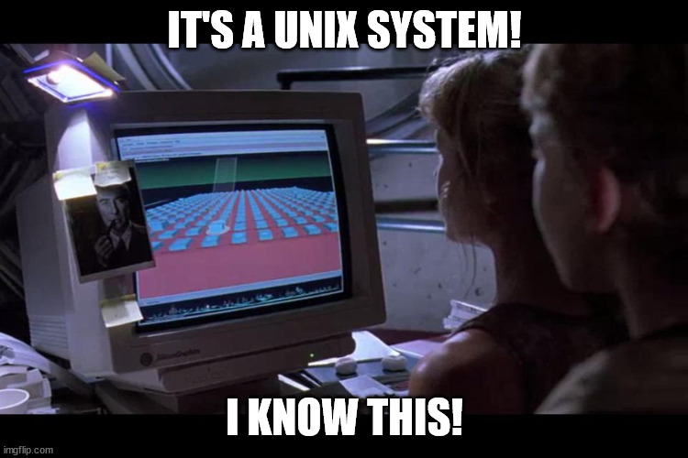
YOU NEVER SAID WHAT UNIX IS
A complete, commercial OS developed by Thompson and Dennis Ritchie at Bell Labs in 1969.
https://www.opengroup.org/membership/forums/platform/unix

Slide 11
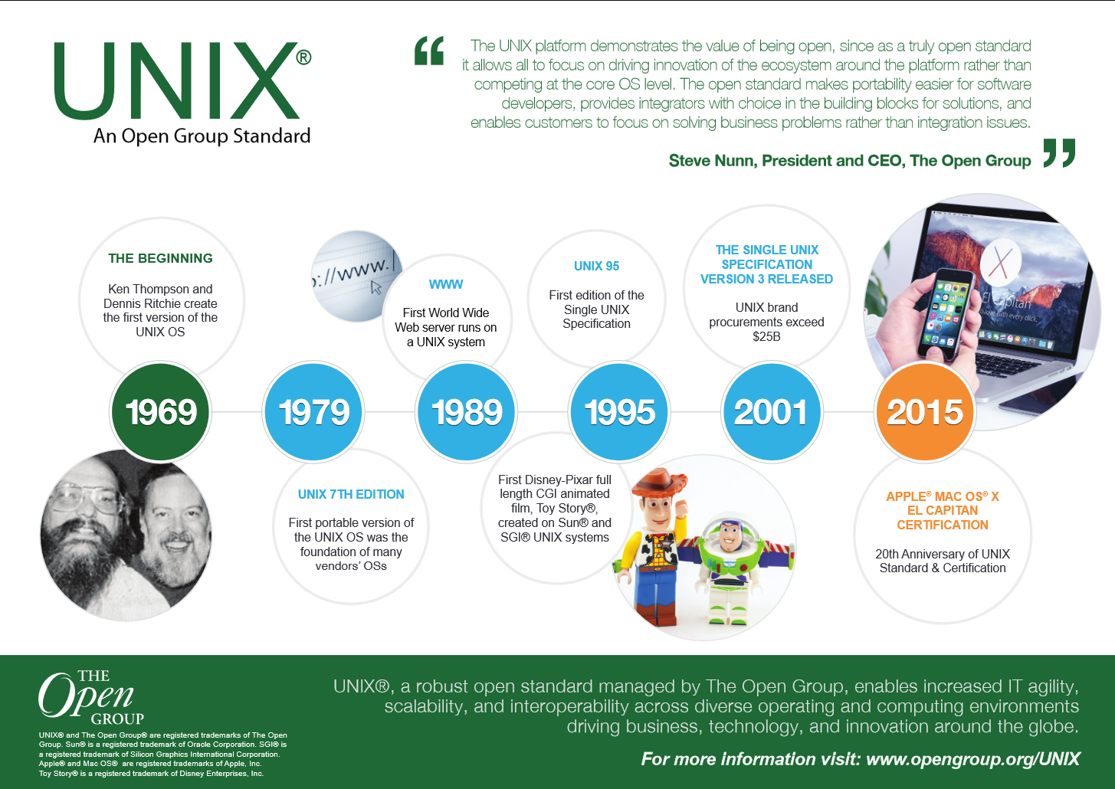

Slide 12
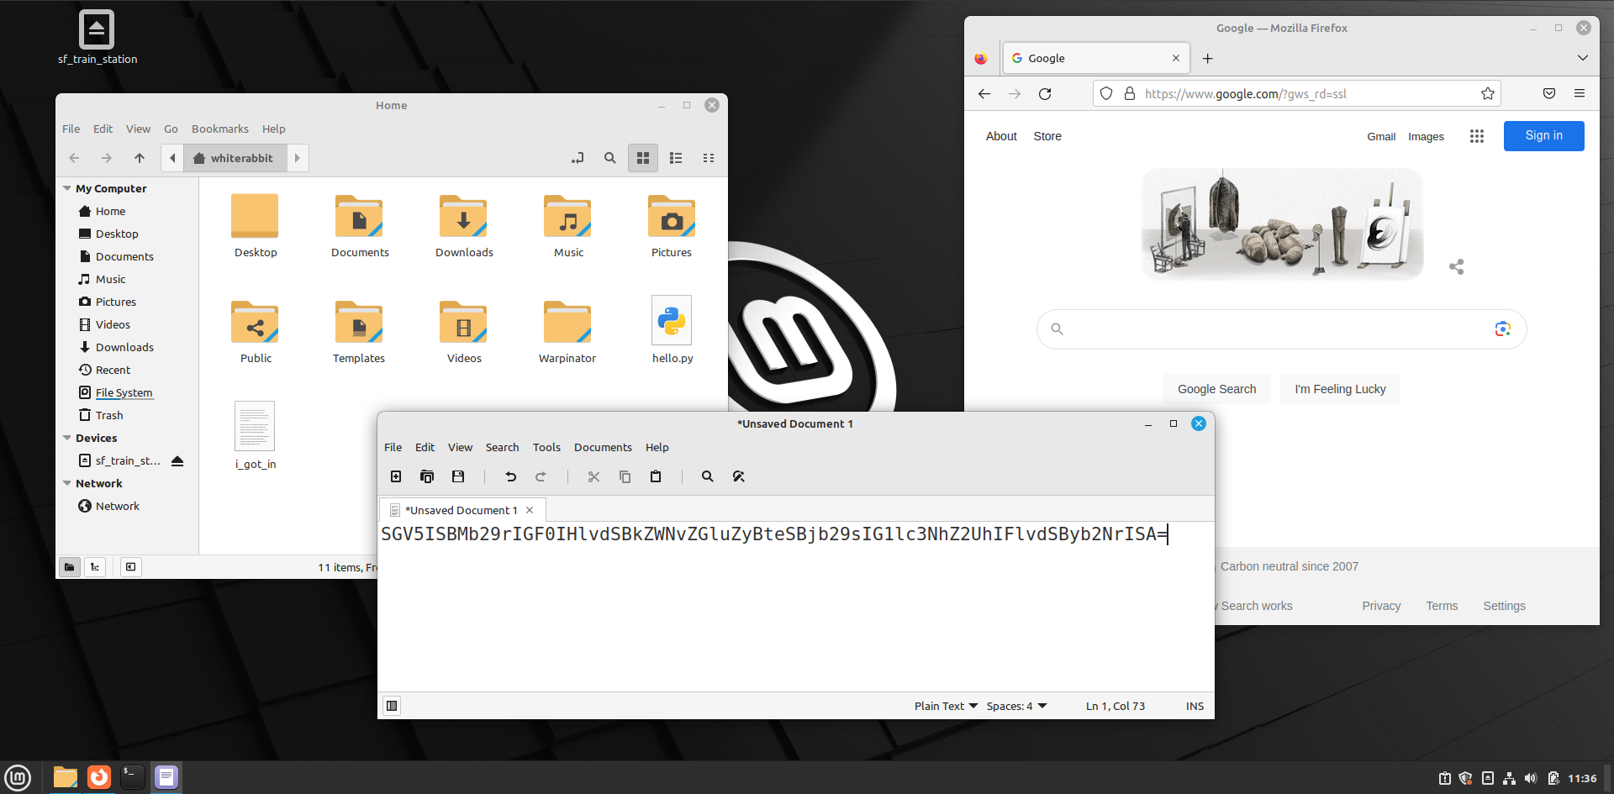
GUI
Graphical User Interface.
Easy to use (hopefully)
Visual
Charts, Graphs, Graphics
Overall a good, universal user experience (hopefully)
Interface

Slide 13
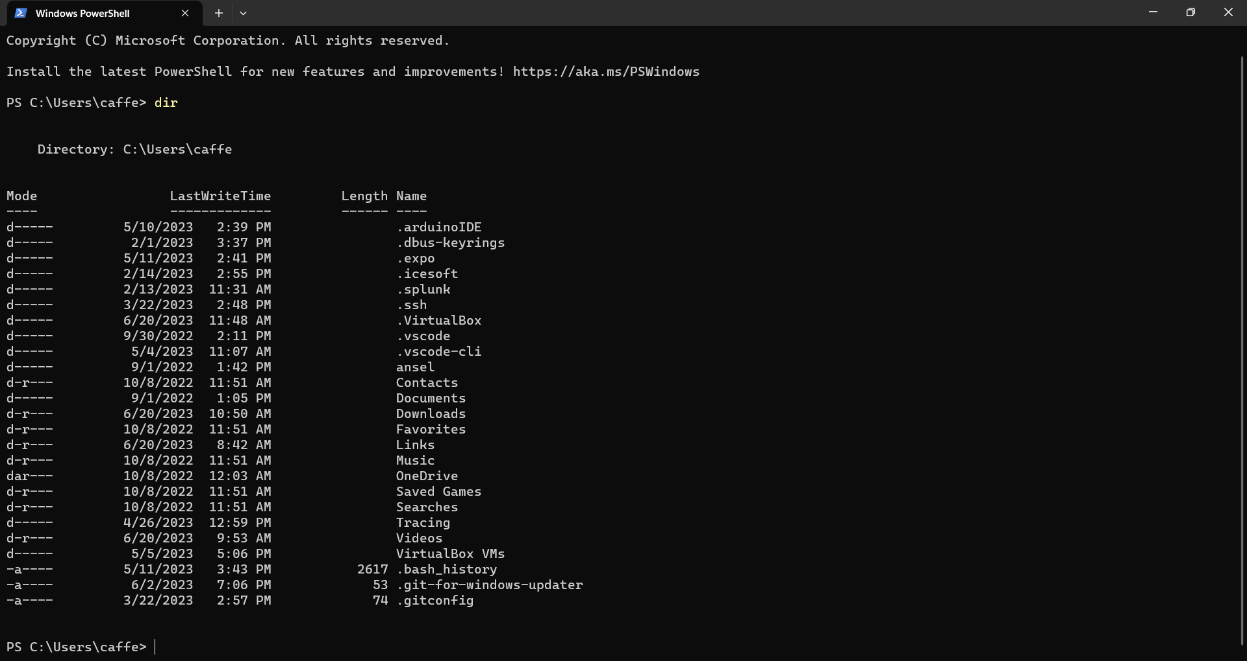
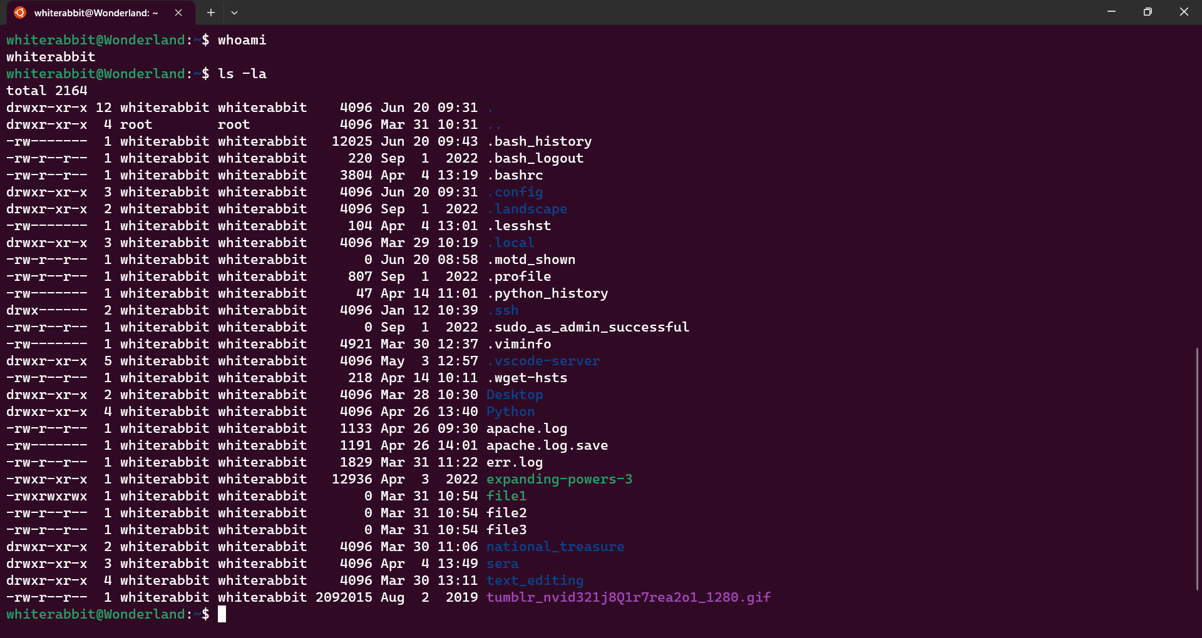

Terminal
Text based
Powerful
Scripting
A bit intimidating
Makes people think you’re a hacker

Slide 14
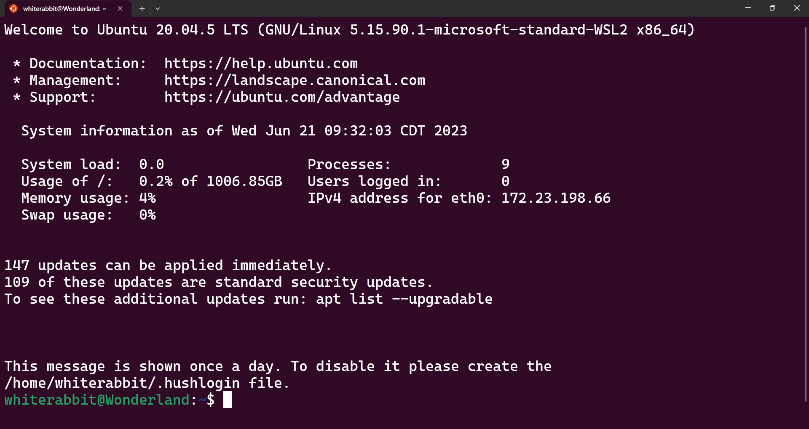
A Closer Look at Terminals
Notes:
whiterabbit – username
Wonderland – server name
~ - current working directory (/home/whiterabbit)
$ - non privileged session

Slide 15
BASH
Bash is the GNU Project's shell—the Bourne Again SHell. This is an sh-compatible shell that incorporates useful features from the Korn shell (ksh) and the C shell (csh). It is intended to conform to the IEEE POSIX P1003.2/ISO 9945.2 Shell and Tools standard. It offers functional improvements over sh for both programming and interactive use. In addition, most sh scripts can be run by Bash without modification.
https://www.gnu.org/software/bash/

Slide 16
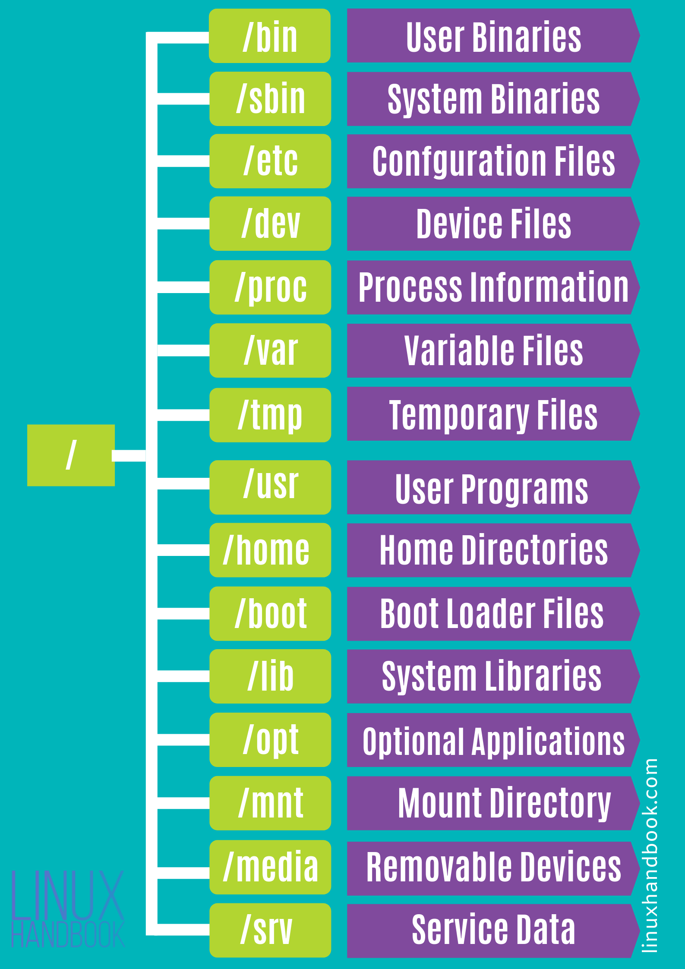

Linux Structure
“/” or is it “root”

Slide 17
Absolute Vs Relative Paths
/home/whiterabbit Vs ~
. Right here in the directory I currently am in
.. One directory above where I currently am
Remember the top directory in Linux is /

Slide 18
Commands
ls and ls ‑l
pwd
cd
touch
mkdir
file
tree
ls and ls ‑l
pwd
cd
touch
mkdir
file
tree
cp and cp ‑r
mv
rm and rm ‑r
cat
more
less
head
tail
man
Sort
DO NOT ATTEMPT TO MEMORIZE ALL COMMANDS

Slide 19
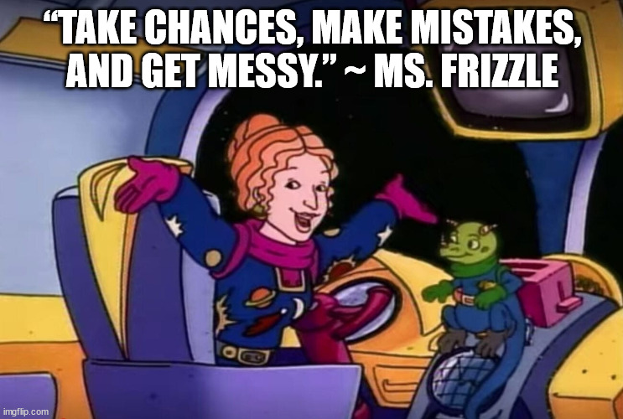
Hands on Keyboards!
Listening to lectures and watching videos has diminishing returns. The best way to learn is to try and maybe fail, but then regroup and keep on trying.

